Slide 1

ITS30705 CHAPTER 5: LOGIC and indefinite loops

Slide 2
CONTENT
Introduction
For loop
While loop
Break
Continue

Slide 3
Categories of loop
A repetition flows specifies that an action is to be repeated while some conditions remain true.
In Python, there are two loop statement: for and while.
Definite loop: Executes a known number of times.
Example:
Indefinite loop: One where the number of times its body repeats is not known in advance
Example:
Prompt the user until the user enter a non-negative number
Print random numbers until a prime number is printed
Repeat until the user typed “q” to quit
Print ”hello” 10 times
Find all the prime numbers up to an integer n
Print each add number between 5 and 127

Slide 4
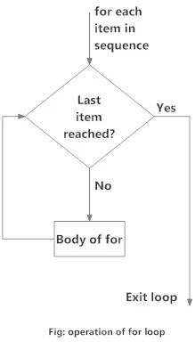
FOR LOOP
The for loop in Python is used to iterate over a sequence (list, tuple, string) or other iterable objects. Iterating over a sequence is called traversal.
Syntax:
Here, val is the variable that takes the value of the item inside the sequence on each iteration.
Loop continues until we reach the last item in the sequence. The body of for loop is separated from the rest of the code using indentation.
for val in sequence:
loop body

Slide 5
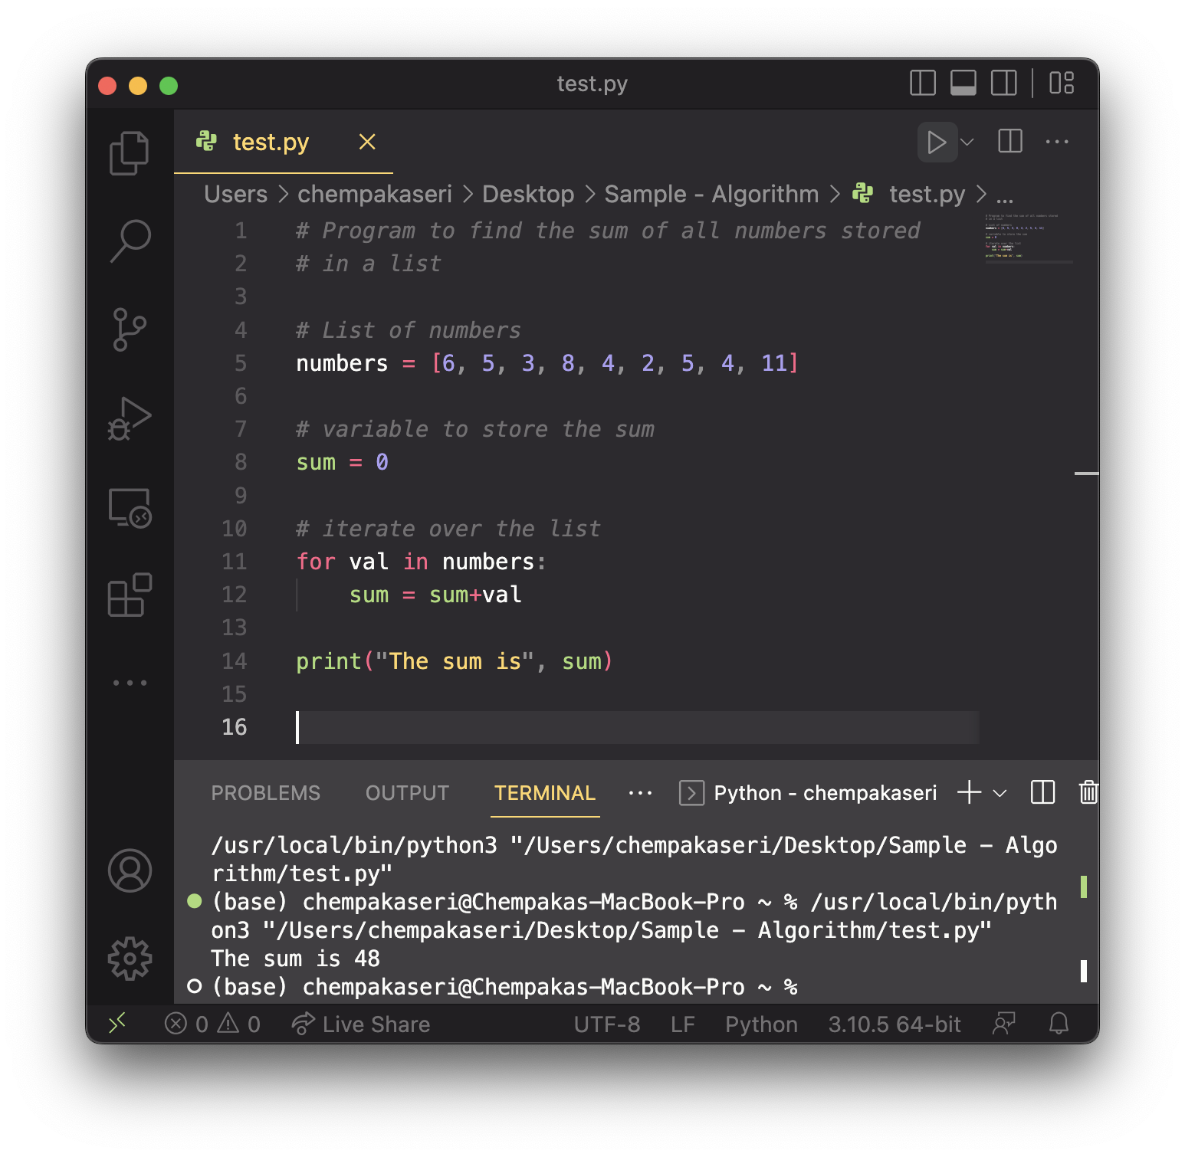
FOR LOOP

Slide 6
THE RANGE() FUNCTION
We can generate a sequence of numbers using range() function. range(10) will generate numbers from 0 to 9 (10 numbers).
We can also define the start, stop and step size as range(start, stop,step_size). step_size defaults to 1 if not provided.
for variable in range (start, stop):
statement
statement
……
statement
header
body

Slide 7
THE RANGE() FUNCTION
Find the sum of all integers from 1-1000
What if we want to sum from 1 – 1,000,000? Or the sum up to any number?
How can we generalize the code?
# This may require a lot of typing
sum = 1 + 2 + 3 + 4 + ...
print("The sum is", sum)
sum = 0
for i in range(1, 1001):
sum += i // sum = sum + i
print("The sum is", sum)

Slide 8
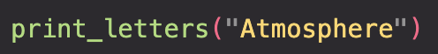
A deceptive problem
Write a method print_letters that prints each letter from a word separated by commas.
For example,
Output:
A,t,m,o,s,p,h,e,r,e

Slide 9
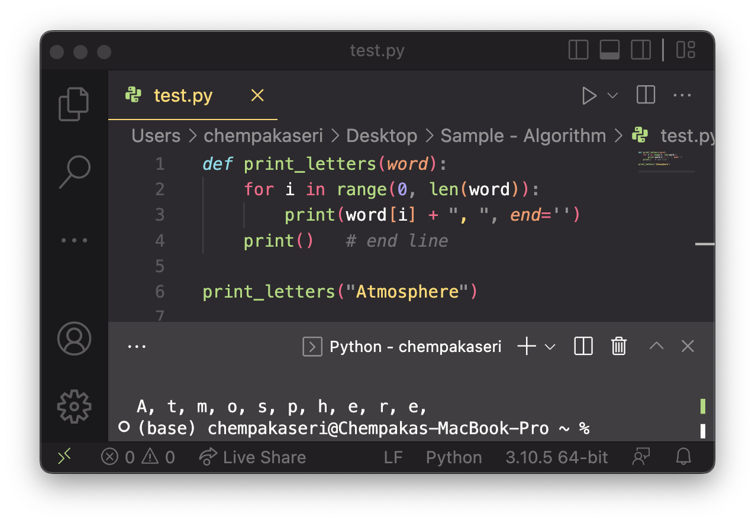
SOLUTIONS… (FLAWED SOLUTION)
Similar to building a fence with wires separated by posts:
If we use a flawed algorithm that repeatedly places a post + wire, however the last post will have an extra dangling wire.
for length of fence :
place a post.
place some wire.

Slide 10
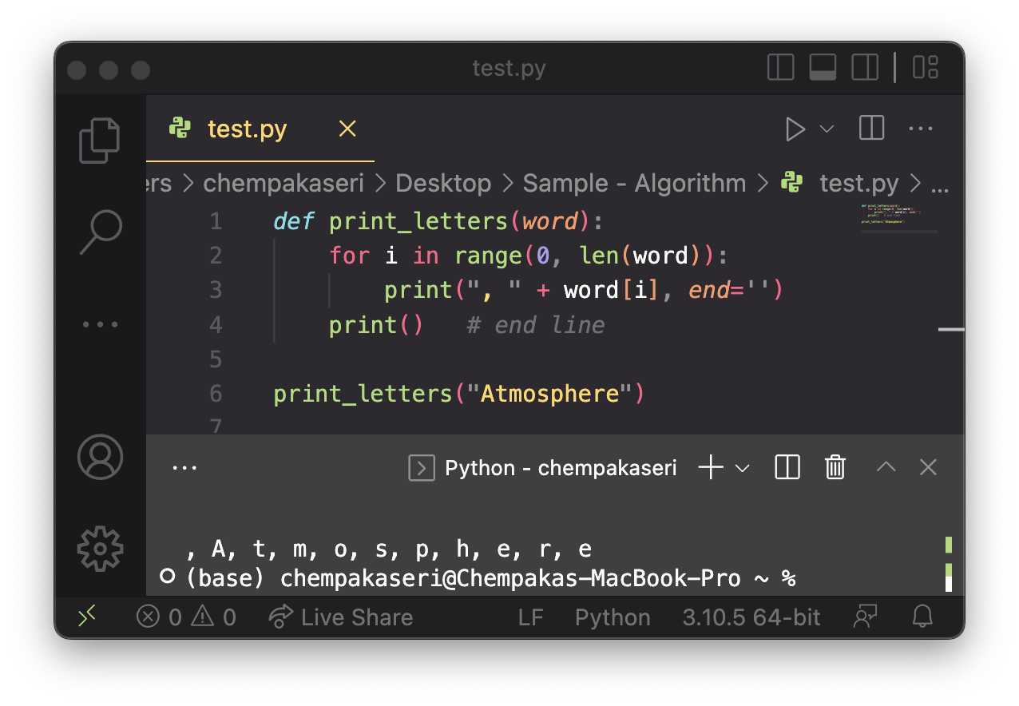
SOLUTIONS…
(FLAWED SOLUTION)
Similar to building a fence with wires separated by posts:
If we use a flawed algorithm, an extra dangling wire before the first post are placed.

Slide 11
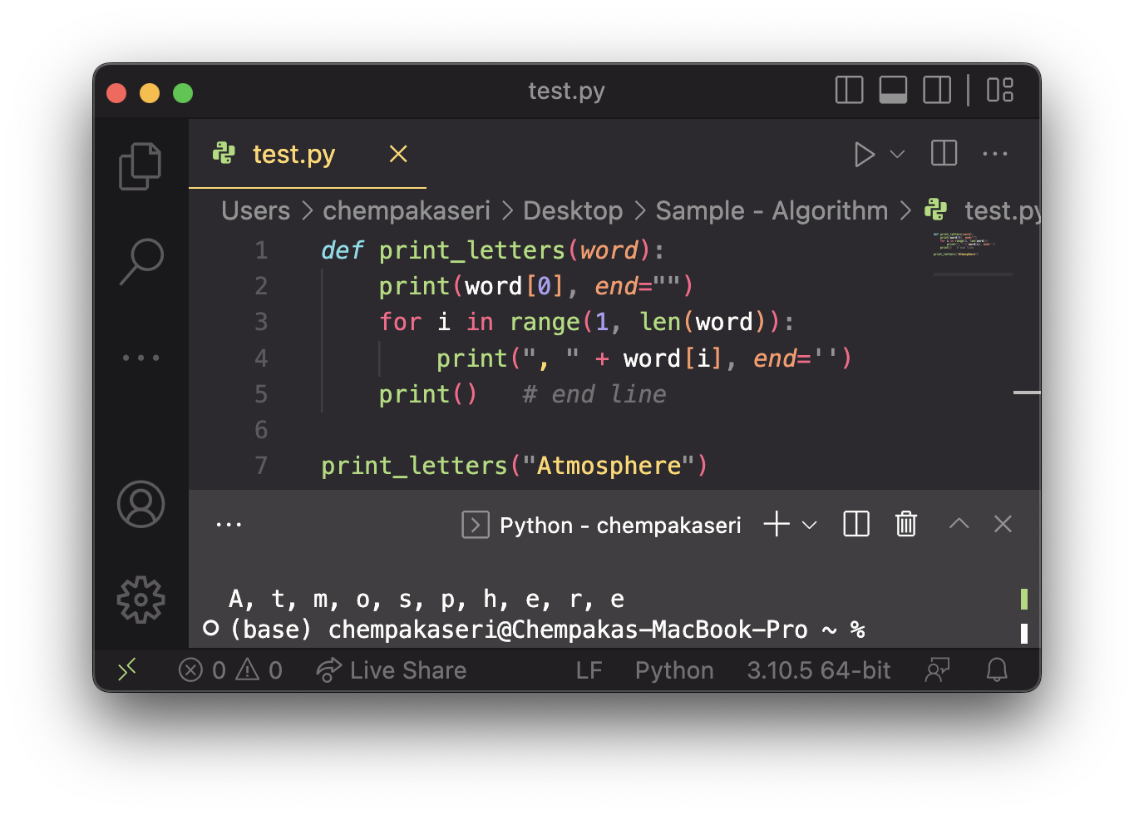
FENCE POST ANOLOGY
To solve this problem, add a statement outside the loop to place the initial “post”.
Also called a fencepost loop or a “loop-and-a-half” solution.
place a post.
for length of fence – 1:
place some wire.
place a post.

Slide 12
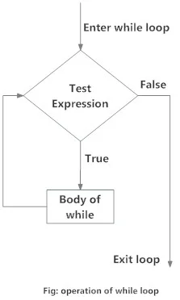
WHILE LOOP
The while loop in Python is used to iterate over a block of code as long as the test expression (condition) is true.
We generally use this loop when we don't know the number of times to iterate beforehand.
Syntax:
while test_expression:
Body of while

Slide 13
WHILE LOOP
while test_expression:
Body of while
In the while loop, test expression is checked first. The body of the loop is entered only if the test_expression evaluates to True. After one iteration, the test expression is checked again. This process continues until the test_expression evaluates to False.
In Python, the body of the while loop is determined through indentation.
The body starts with indentation and the first unindented line marks the end.
Python interprets any non-zero value as True. None and 0 are interpreted as False.

Slide 14
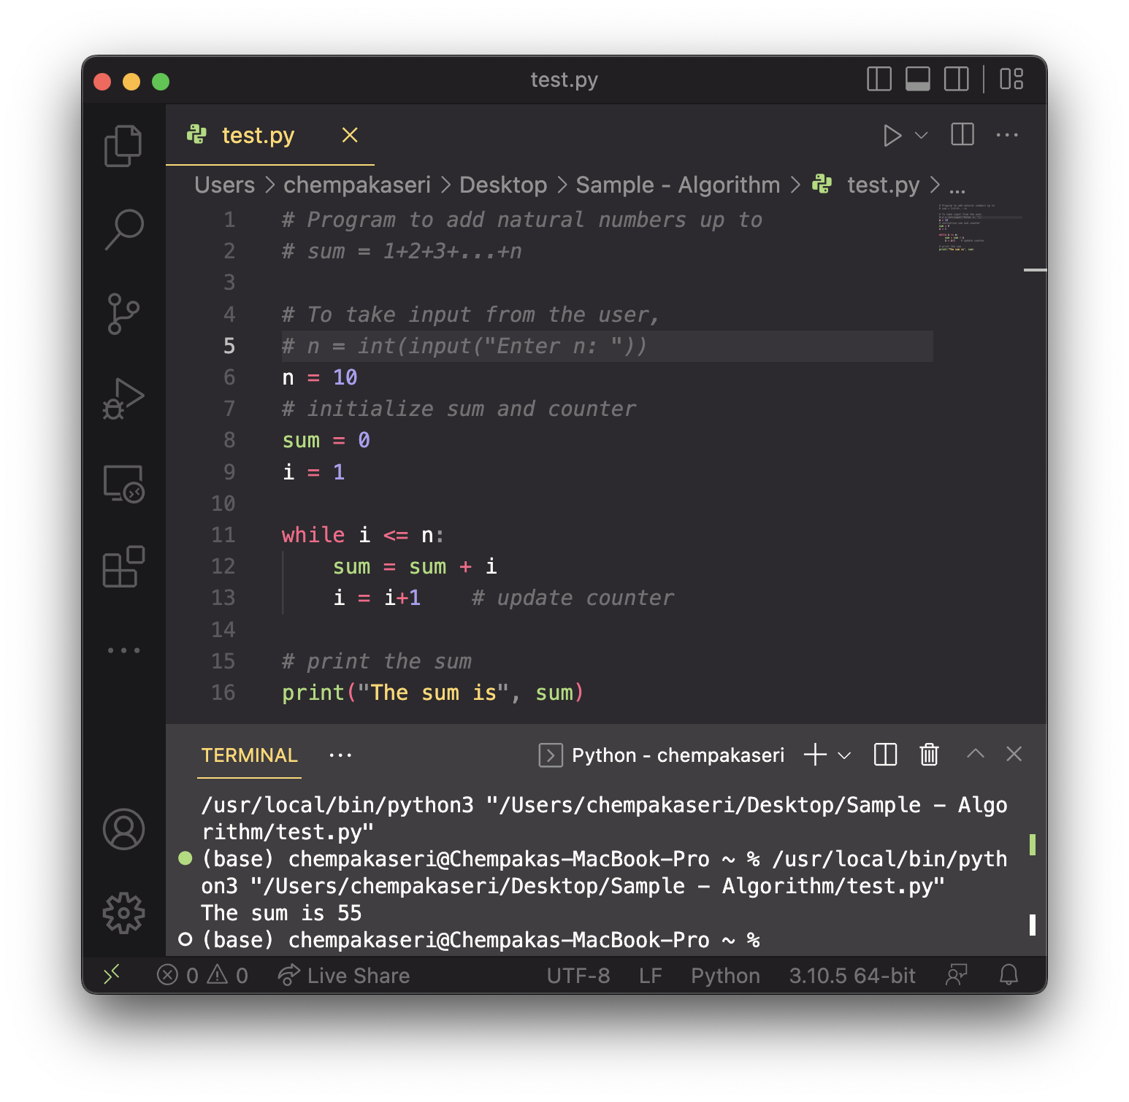
WHILE LOOP

Slide 15
BREAK AND CONTINUE
In Python, break and continue statements can alter the flow of a normal loop.
Loops iterate over a block of code until the test expression is false, but sometimes to terminate the current iteration or even the whole loop without checking test expression.
The break and continue statements are used in these cases.

Slide 16
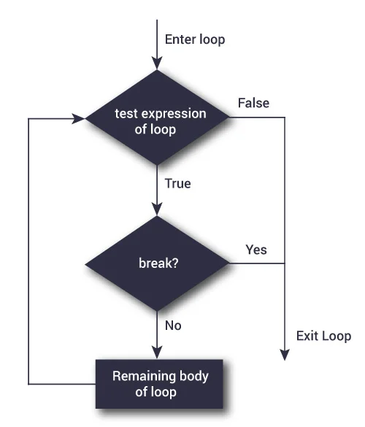
BREAK
The break statement terminates the loop containing it. Control of the program flows to the statement immediately after the body of the loop.
If the break statement is inside a nested loop (loop inside another loop), the break statement will terminate the innermost loop.
Syntax: break

Slide 17
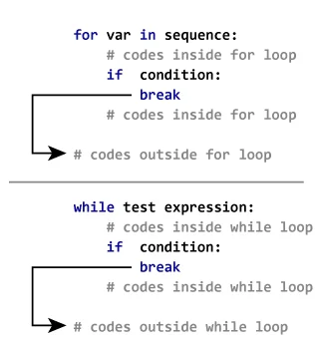
How BREAK statement works in python

Slide 18
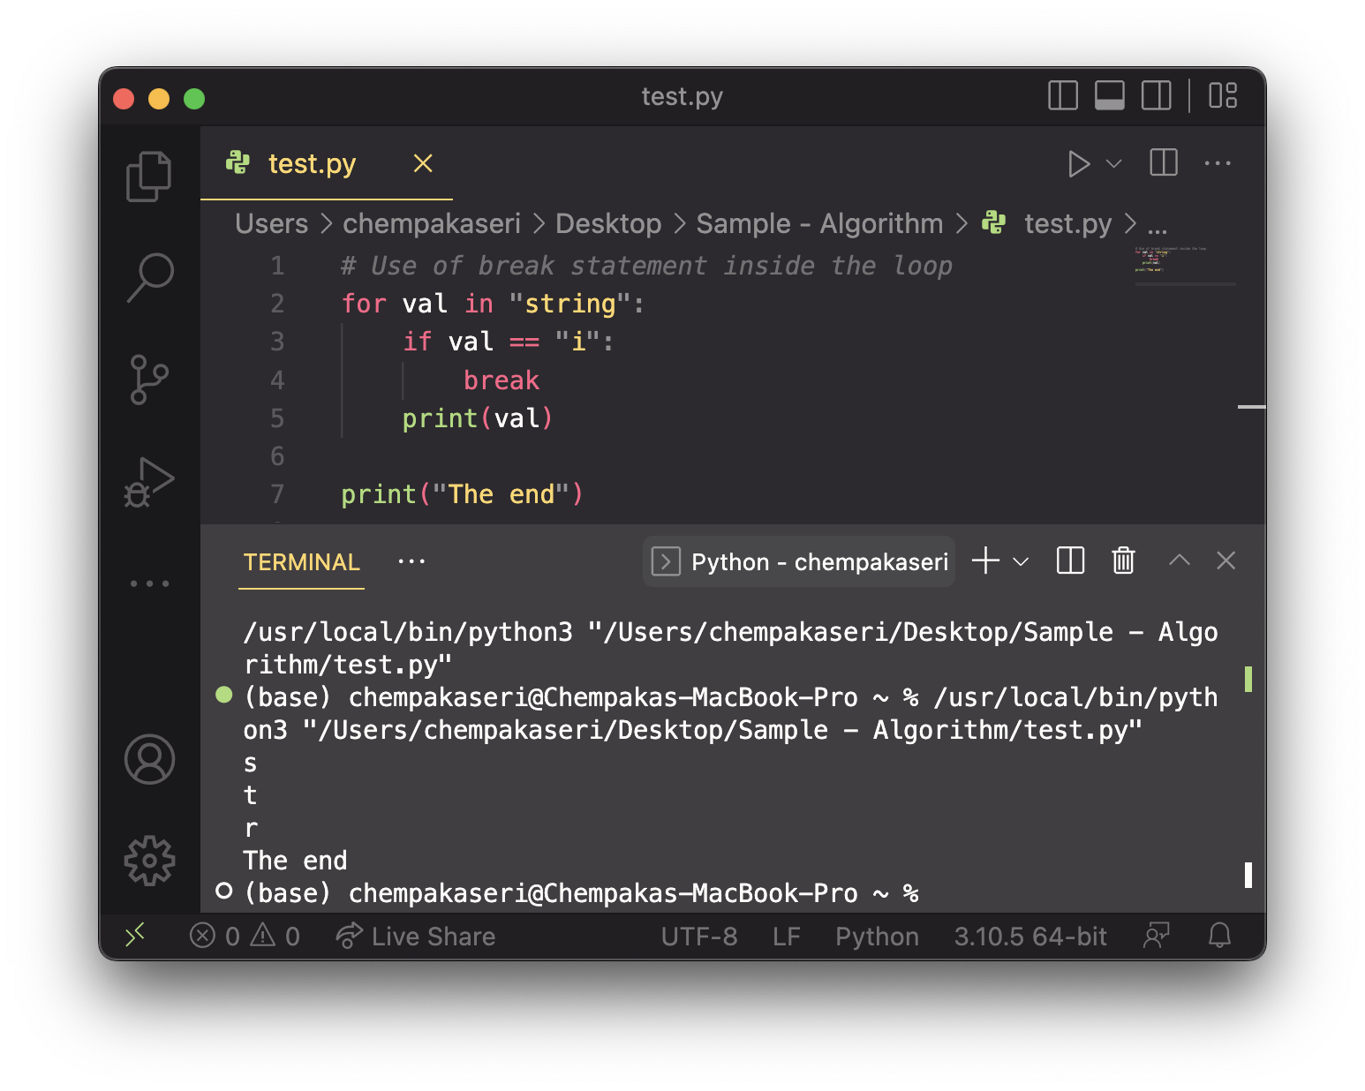
BREAK – EXAMPLE

Slide 19
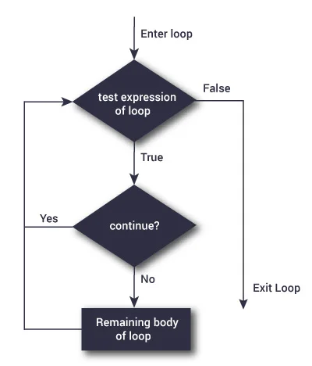
CONTINUE
The continue statement is used to skip the rest of the code inside a loop for the current iteration only. Loop does not terminate but continues on with the next iteration.
Syntax: continue

Slide 20
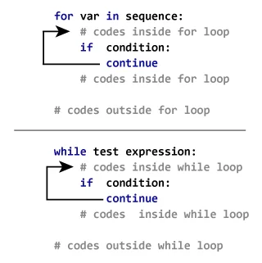
How continue statement works in python

Slide 21
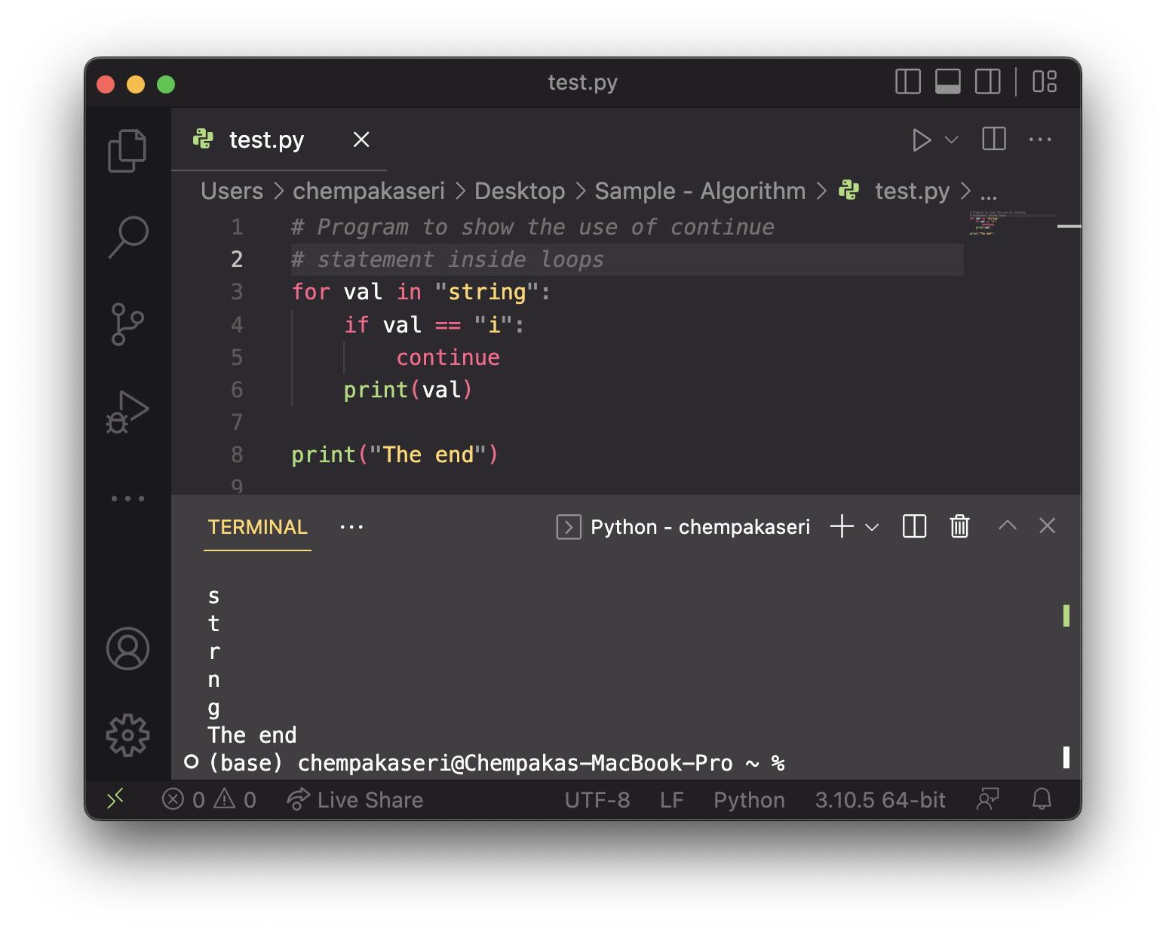
CONTINUE – EXAMPLE

Slide 22
EXERCISE
Write a Program that accept a user input. The system will quit when the user enter quit. (Hint: use while loop and continue)

Slide 23
EXERCISE
Write a program that print the square of numbers from 1 to number 5.
Expected output:
The current number is 1 and the square is 1
The current number is 2 and the square is 4
The current number is 3 and the square is 9
The current number is 4 and the square is 16
The current number is 5 and the square is 25

